Slide 1
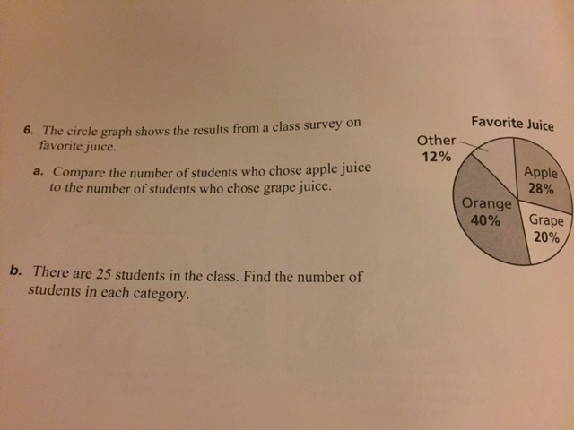
What did the zero say to the number eight? Warm Up

Slide 2
When would a box and whisker plot be useful?
https://www.khanacademy.org/math/probability/descriptive-statistics/box-and-whisker-plots/v/constructing-a-box-and-whisker-plot

Slide 3
What are the limitations of a box and whisker?

